Slide 2
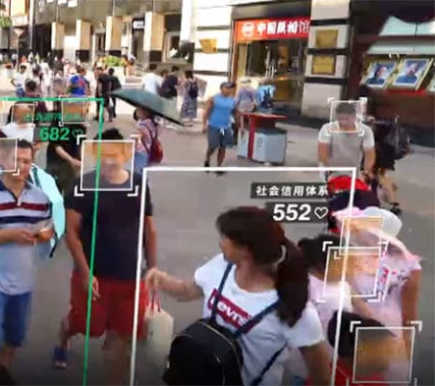
Introduction
This project is motivated by the increase in the usage of face detection.
China → Social Credit System
“it’s a numerical grading system that allows the Chinese government to monitor and control the behavior of its citizens” (Summers 2019).
Positive or negative points leads to sanctions.
OpenCV

Slide 3
Project Overview
Improving the face detection algorithm
Measuring similarity between pictures
Applying filters on faces
Creating a GUI (Graphical User Interface)

Slide 4
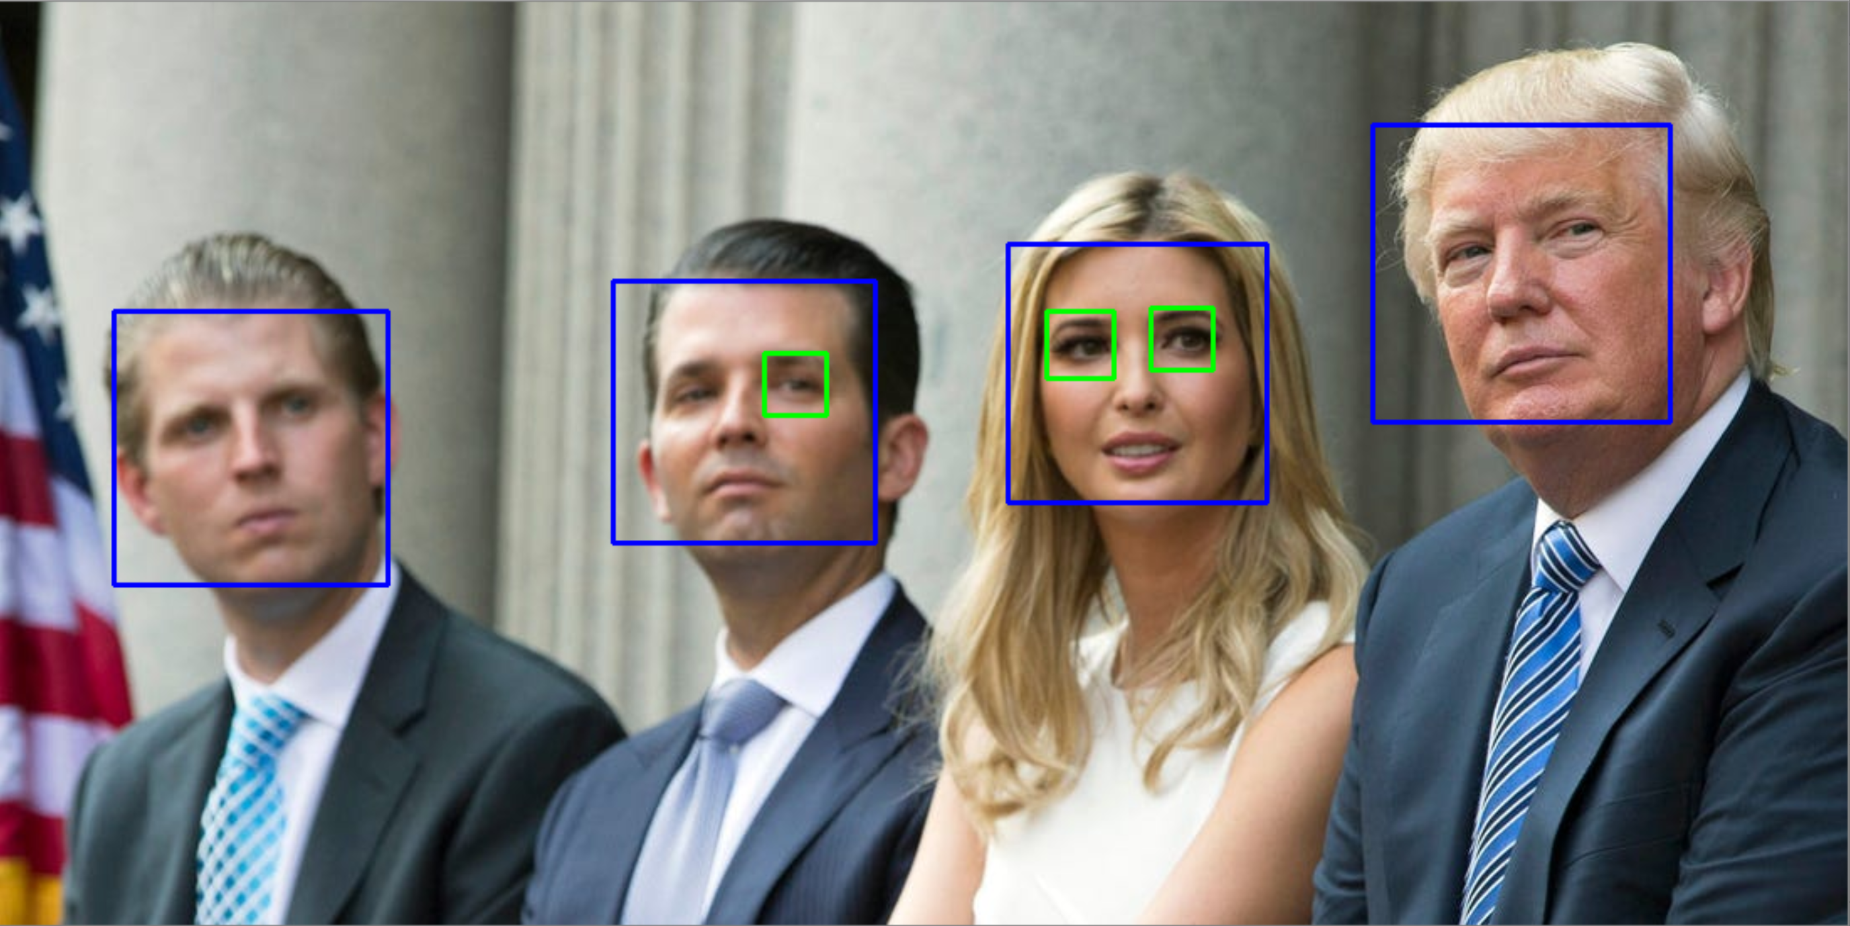
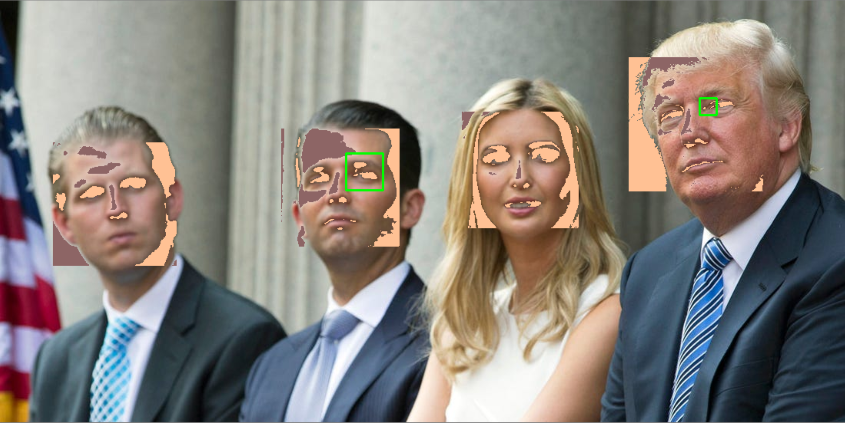
Improving face detection algorithm
Frontal Face Detector and Eye Detector at filtered image
Frontal Face Detector and Eye Detector original image

Slide 5
Apply any Filter on faces
Task 5 and 6:
Blur or filter the given location
A set of filters (Master filter, standard bluring CV2, Gaussian filter, pixel shifter)
Coloured or gray toned image
Unterstand the openCV face dedector
My main goal:
Minimal impact on the image for the human eye/face dedection
What are the opportunities?
What I did:
Four filters that you can apply more the one time
Trying to optimize the filter
Notes:
Hi my name is Beat Furrer and I will show you something about filtering.
The group assigned me tasks 5 and 6. My task was to change a certain area in an image so that the face recognition algorithm could no longer recognize the faces. The simplest case is to use the existing bluring opencv function.
Then I added 3 more filters by myself. I will show you in the demonstration how these filters work. It is easier to understand, when you could see it life on an example.
My main goals would be to generate a minimal impact on the face in the picture. This means that for the human eye and for the whole process in the brain, facial recognition, there should be hardly any difference between the original and the changed image.
But I mean, the facial recognition process in the human brain is so complex and individual that I just applied some filters. I just did tests and checked, by myself, whether I can still see the faces. And where are the smallest changes.
In order to understand which parameters I can change; I first have to understand how the openCV works.
It is a machine learning based approach where a cascade function is trained from a lot of positive and negative images. Now let’s see how this algorithm concretely works. The idea of Haar cascade is extracting features from images using a kind of ‘filter’, like the concept of the machine learning and neuronal network.s These filters are called haar features and look like that:
edge features
line features
Let me explain this issue an example.
Now I understand how the detector works and can therefore outsmart it. My task was clear, I have to reduce or even reverse the difference between the light and dark areas on the face.
Because the algorithm performs a summation of the areas, I thought it would be enough to just make a few pixels black and the other white. Now let's see in the demonstration what success I had with it.

Slide 6
Demonstration and lesson learned
Demonstration
Depend on the picture how good the opencv face dedector regognize a face
Difficult to understand what are values or parameters to adujst that the opencv doesn’t dedect any faces.
Notes:
We had some troubles with the integration of the different modules into the GUI build with the PyQT5. So in this case I will show you a smaller GUI implemented with the t-kinter or I don’t know how does it call. I did it because my knowledge about implementing GUI in python is very low and I was very interested in it. But on the opposite, I build many GUI’s in other programming langugues, so in thise case I was pretty familiar what the basic principle are.
Okey let’s start the demonstration.
At the beginning I had to upload an image, doesn’t matter what size because the program automatically decrease the size down to 600 pixels. Okey I hope you remember this guy.
The biggest challenge was to understand which parameters and values have to be changed so that the opencv no longer recognizes the faces.

Slide 7
Lists of references
Summers, Josh (2019): China’s Social Credit System and Froeigner Grading System. https://www.travelchinacheaper.com/china- social-credit-system-explained. Access 15.12.2019.

